Slide 1

Innovazioni nella Tecnologia delle Suturatrici
Dott. Simone Targa
U.O.C. Chirurgia Generale
CENTRI OBESITÀ ROVIGO-ADRIA
AULSS 5 Polesana

Slide 2
DISCLOSURE
I have NO financial disclosure or conflicts of interest with the presented material in this presentation.

Slide 3
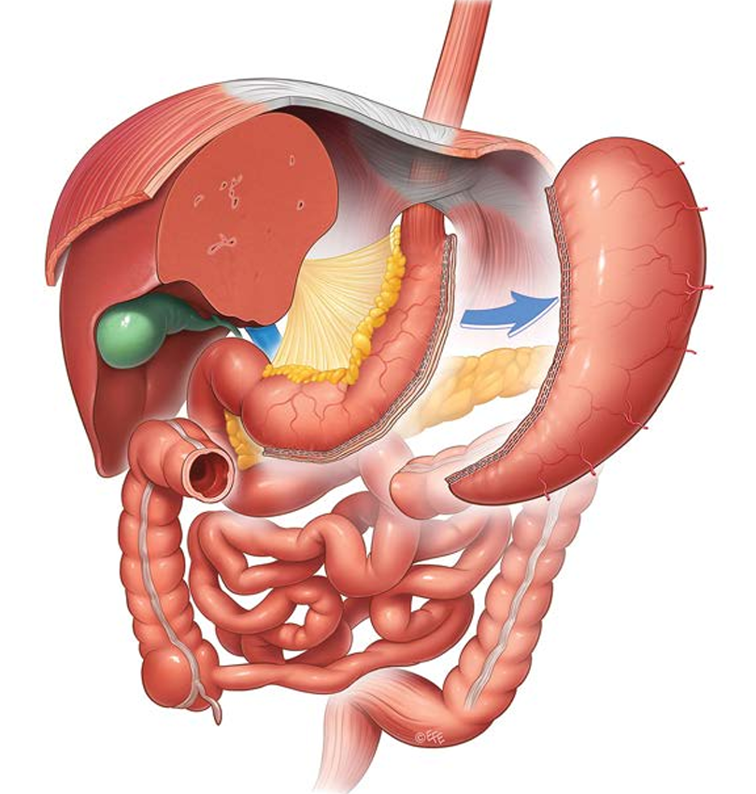
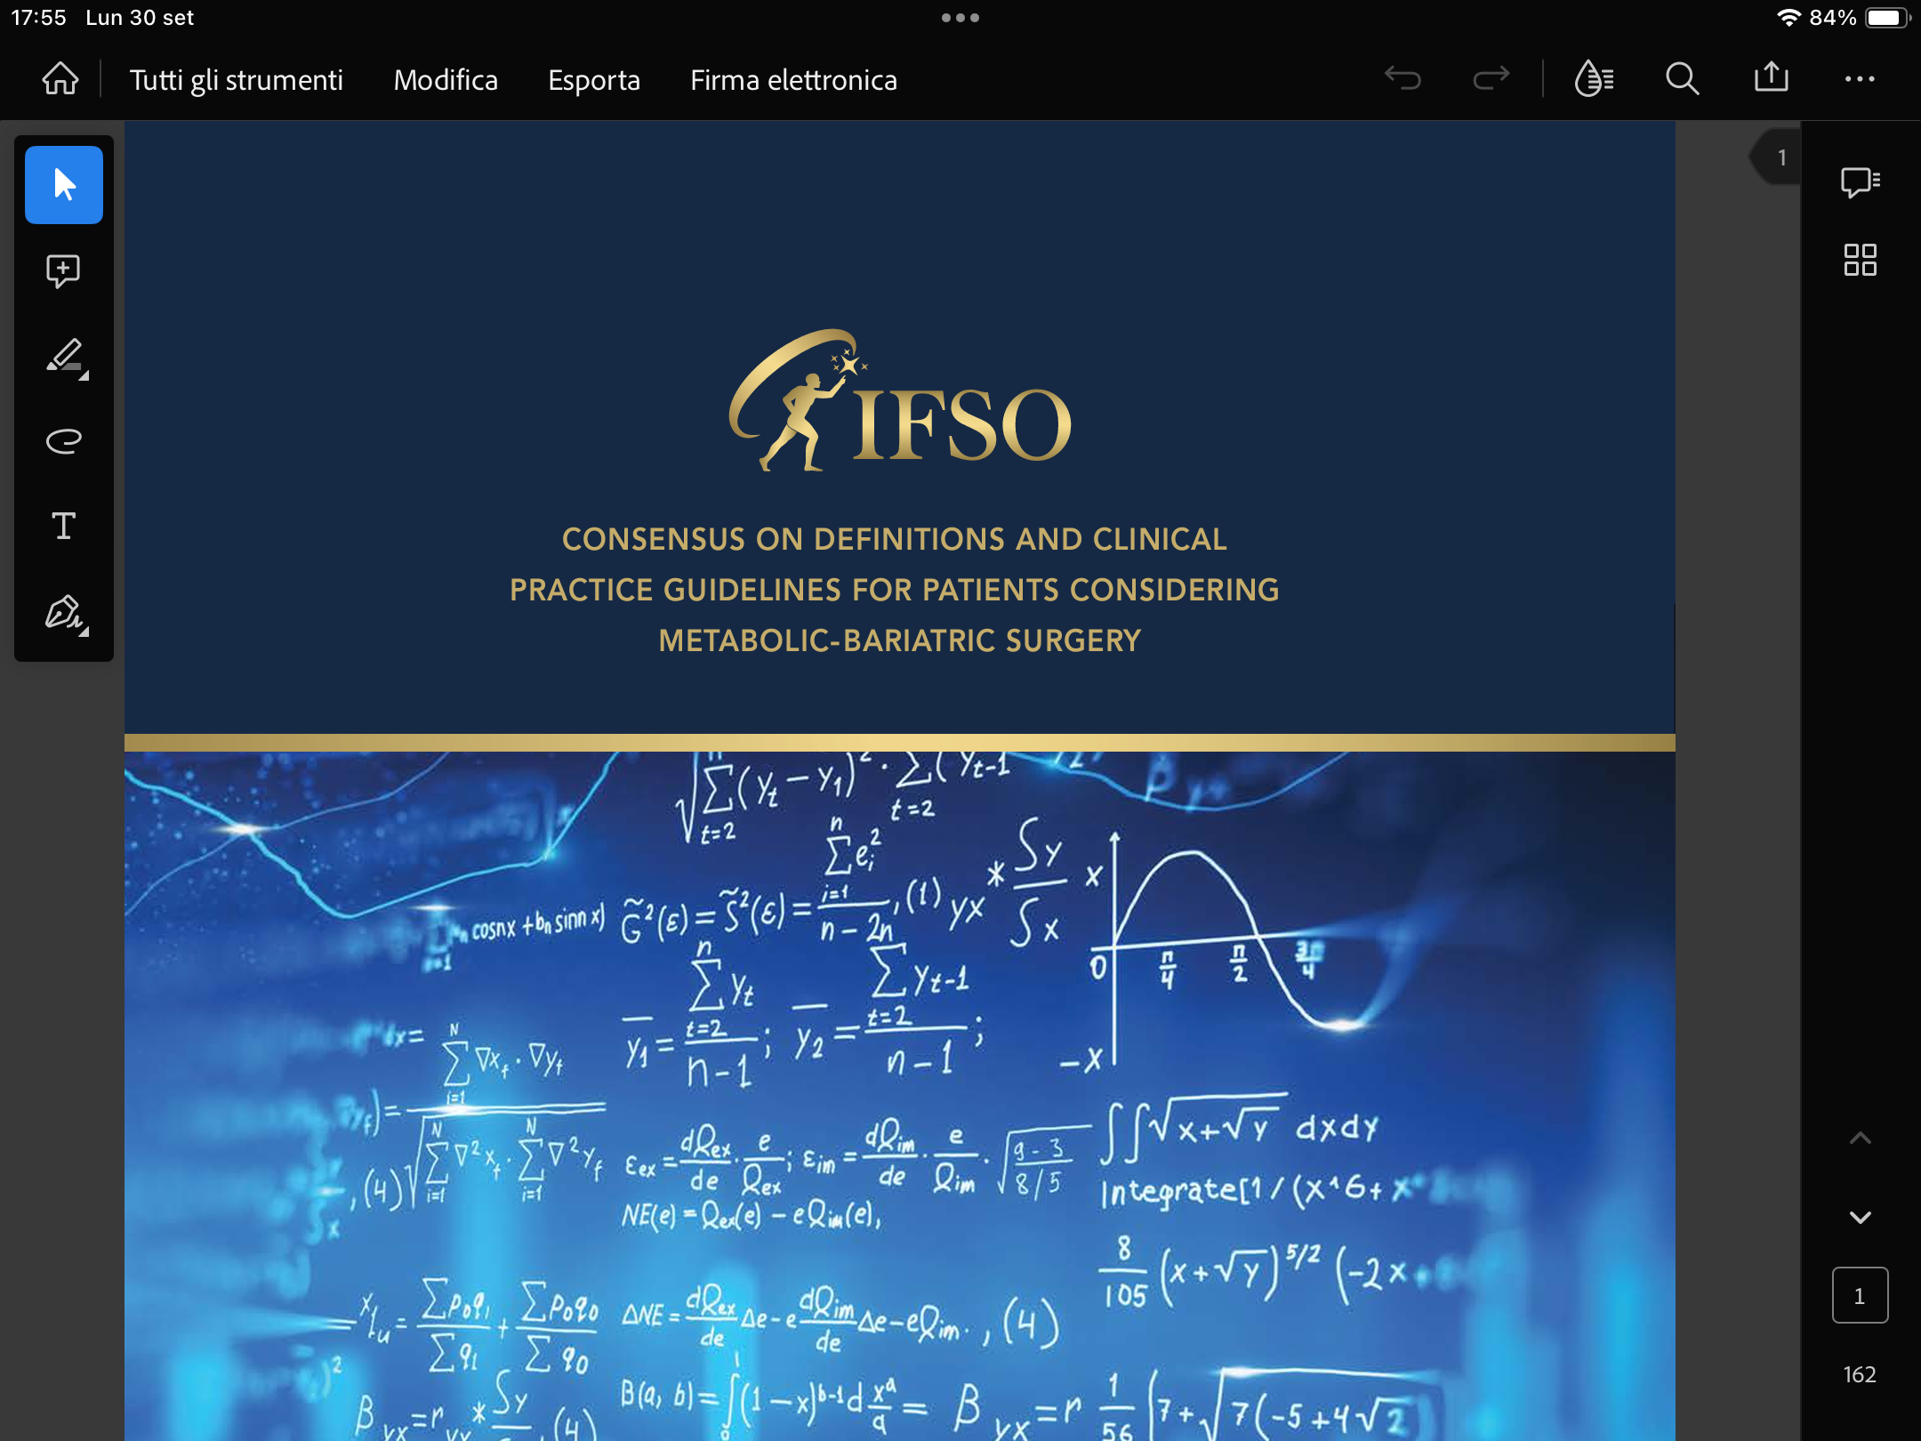
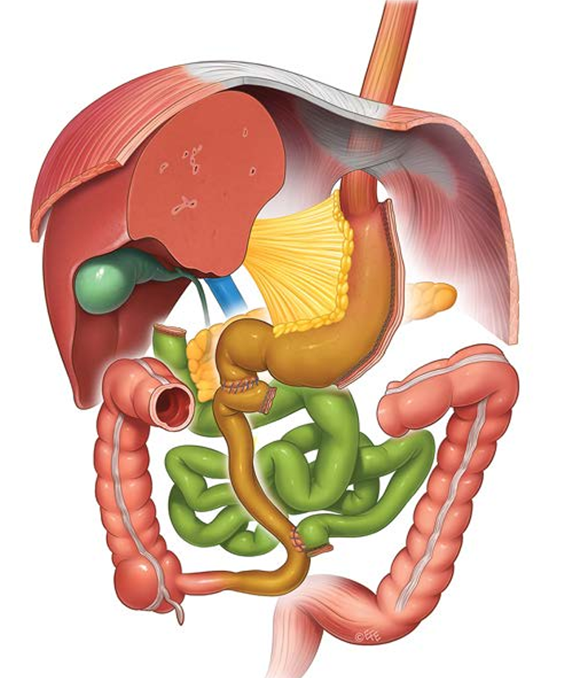
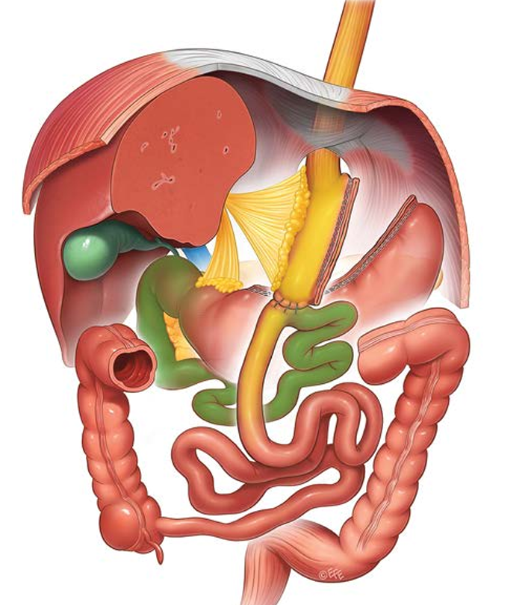
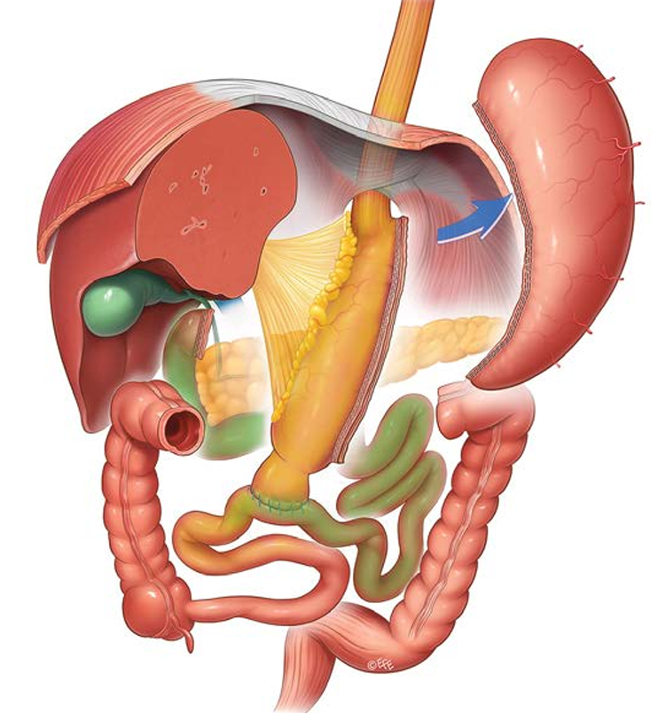
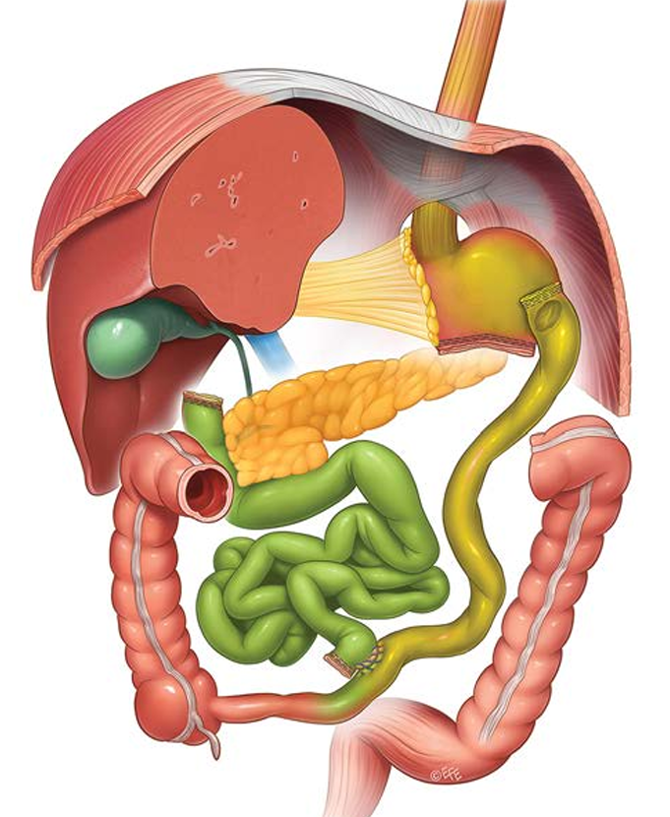
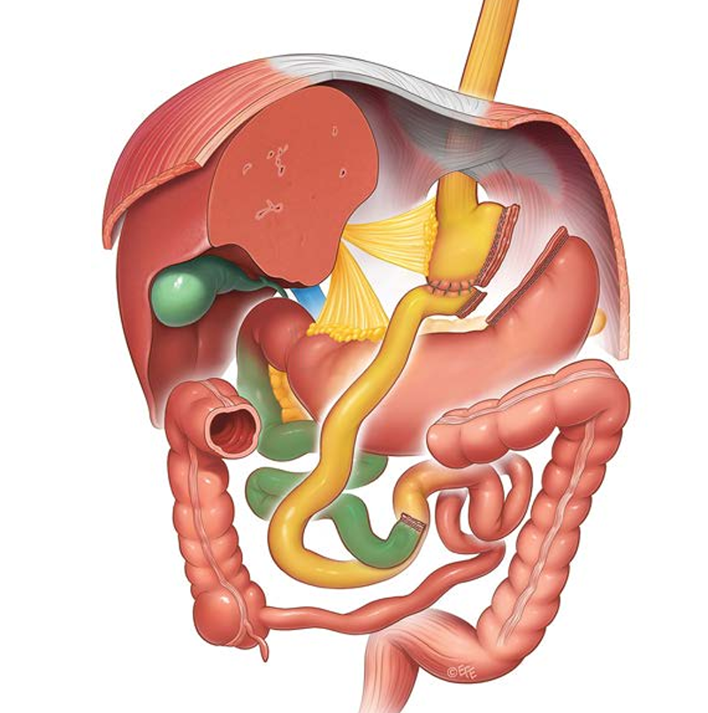
Duodenal Switch
Sleeve Gastrectomy
RYGB
OAGB
Biliopancreatic diversion
IFSO Consensus Conference 2023 Book
SADI-S

Slide 4
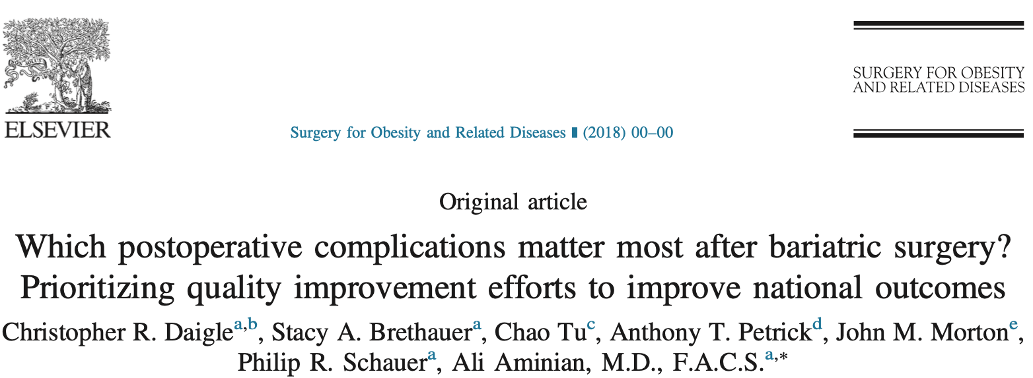
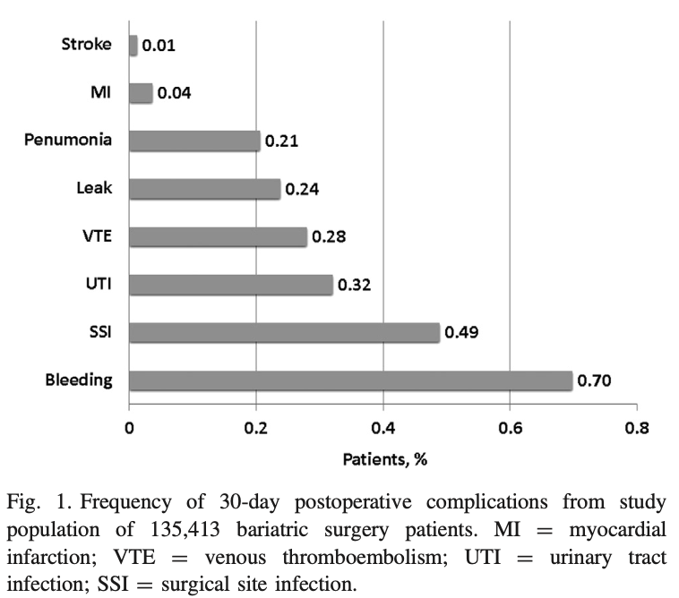
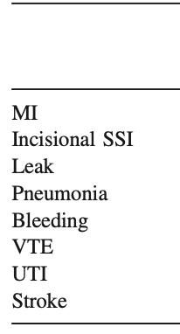
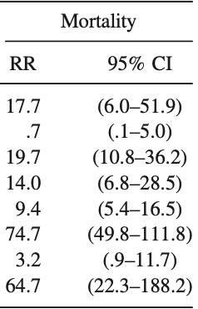

Slide 5
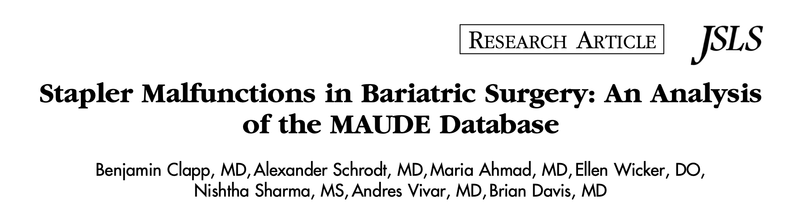
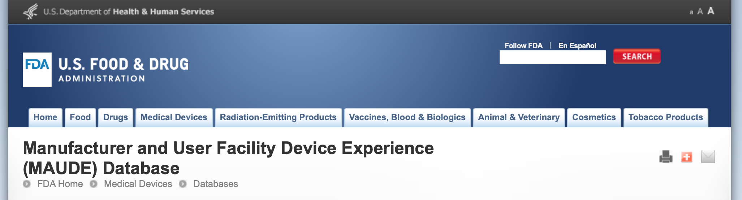
Failure to fire
Malformed staples
Handles that lock up
«No matter how advanced these staplers become, there will still be failures as with any mechanical device».
Clapp B, Schrodt A, Ahmad M, Wicker E et al.. Stapler malfunctions in Bariatric Surgery: an analysis of the MAUDE database. JSLS. Jan-Mar 2022; 26:1.

Slide 6
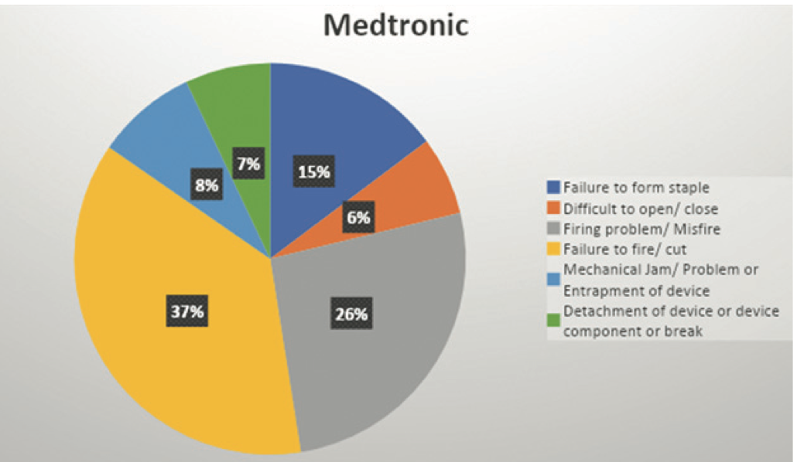
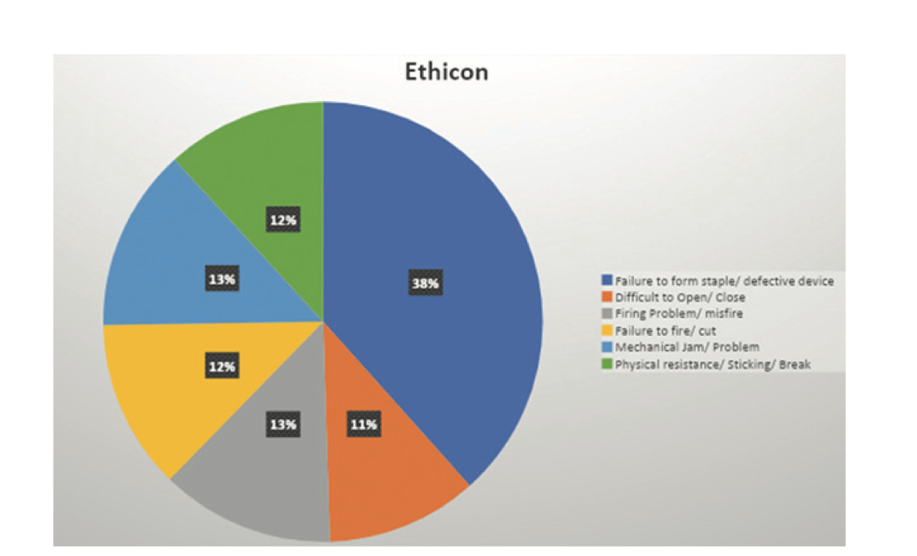
Clapp B, Schrodt A, Ahmad M, Wicker E et al.. Stapler malfunctions in Bariatric Surgery: an analysis of the MAUDE database. JSLS. Jan-Mar 2022; 26:1.

Slide 7
January 1, 2018 – December 31, 2020
30, 5 million staple reloads used for Sleeve Gastrectomy and RYGB
883 adverse events reported for Medtronic
353 adverse events reported for Ethicon
35 adverse events reported for Intuitive
Clapp B, Schrodt A, Ahmad M, Wicker E et al.. Stapler malfunctions in Bariatric Surgery: an analysis of the MAUDE database. JSLS. Jan-Mar 2022; 26:1.

Slide 8
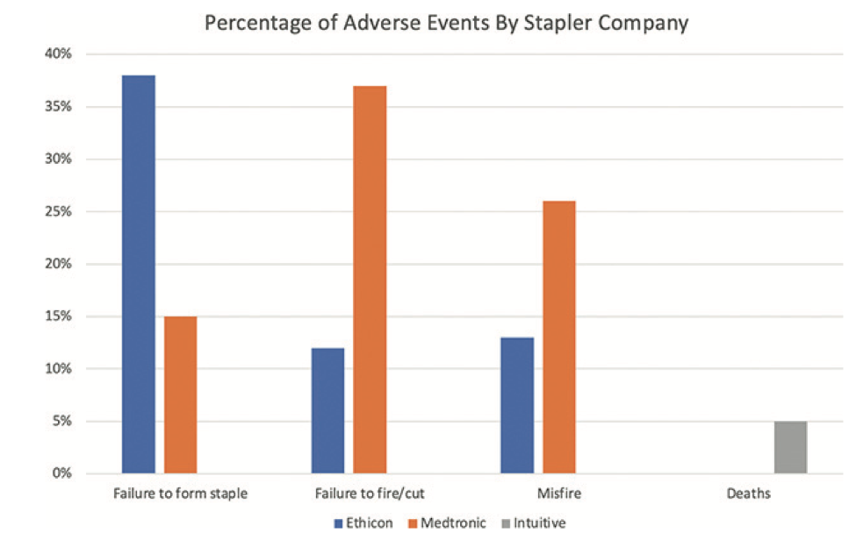
Stapler malfunction is a very rare event in metabolic and bariatric surgery. All of the major stapler producers have transitioned to powered staplers with excellent safety profiles.
The robotic stapler is still in its infancy and its safety profile is more difficult to determine given the lack of data about it.
Open and honest reporting about stapler malfunction is essential to determine the true safety of these ubiquitous devices.
Clapp B, Schrodt A, Ahmad M, Wicker E et al.. Stapler malfunctions in Bariatric Surgery: an analysis of the MAUDE database. JSLS. Jan-Mar 2022; 26:1.

Slide 9
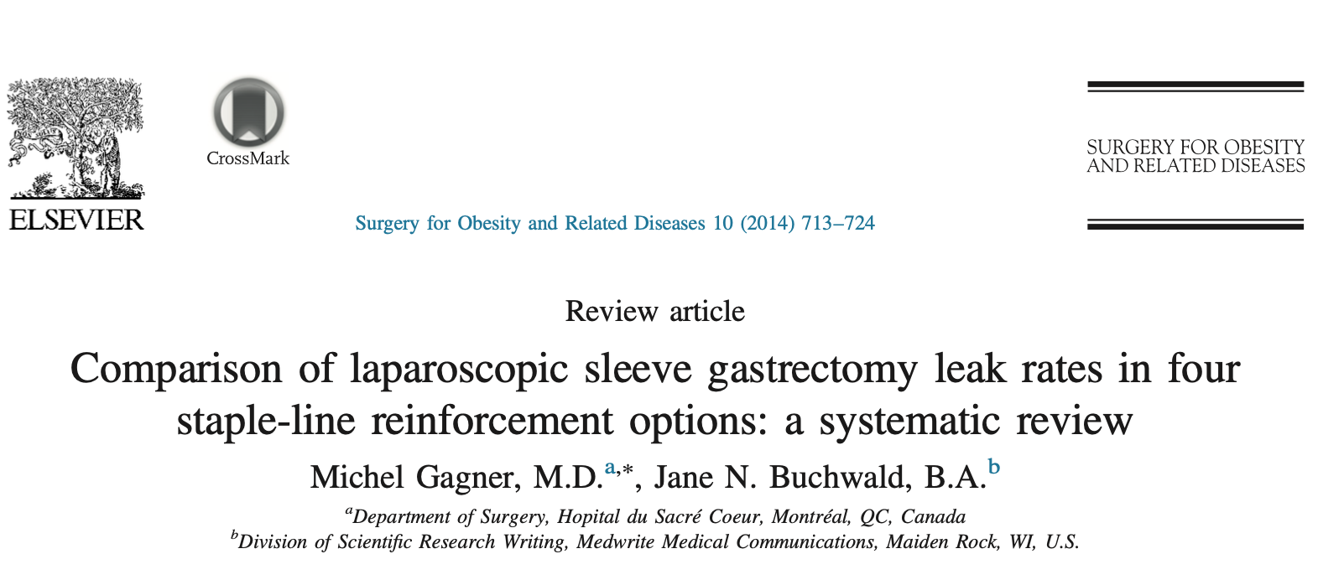
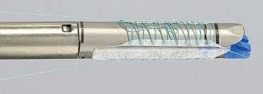
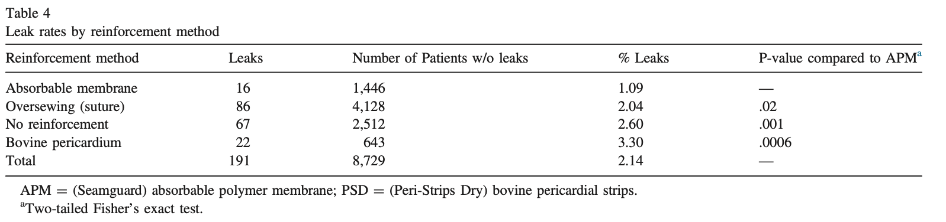
2014
No reinforcement (NO-SLR)
Oversewing (suture)
Nonabsorbable bovine pericardial strips (BPS)
Absorbable polymer membrane (APM)

Slide 10
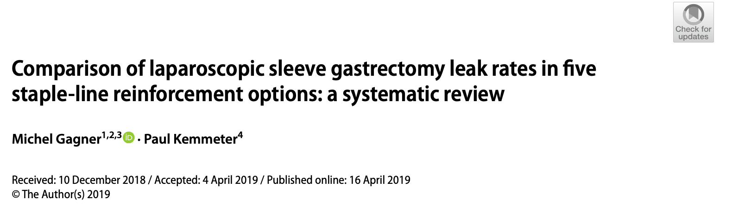
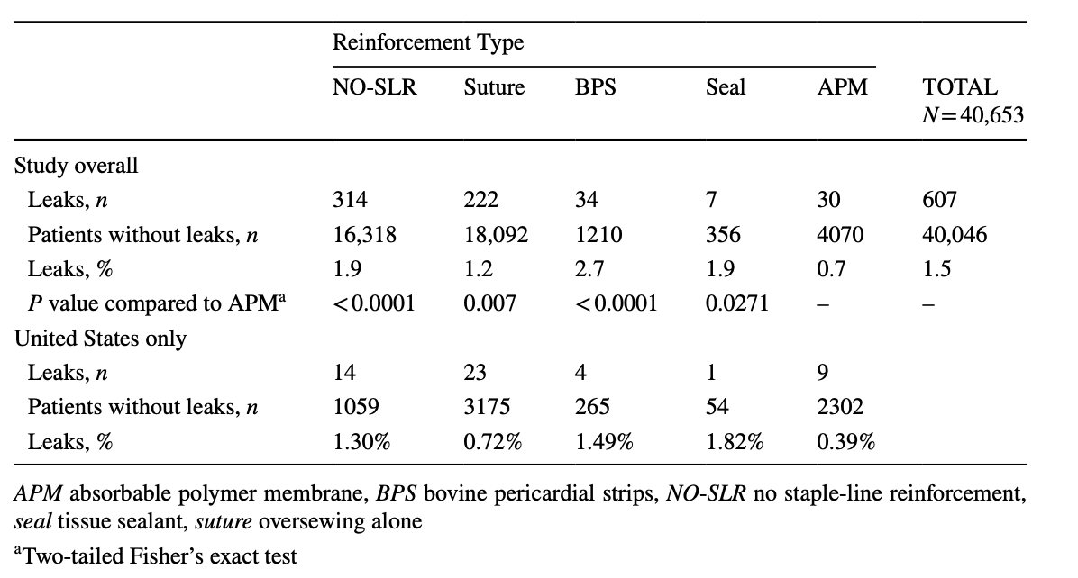
2019
No reinforcement (NO-SLR)
Oversewing (suture)
Nonabsorbable bovine pericardial strips (BPS)
Tissue sealant or fibrin glue (Seal)
Absorbable polymer membrane (APM)

Slide 11
2014
2019
 | 2014 | 2019
Leak rate overall | 2,14 % | 1,5 %
Leak NO-SLR | 2,6 % | 1,9 %
Leak APM | 1,09 % | 0,7 %
Leak rate has decreased overall
APM has the lowest leak rate among types of reinforcment
No difference between NO-SLR and SEAL
Surgeon technique and skills associated with improved outcomes

Slide 12
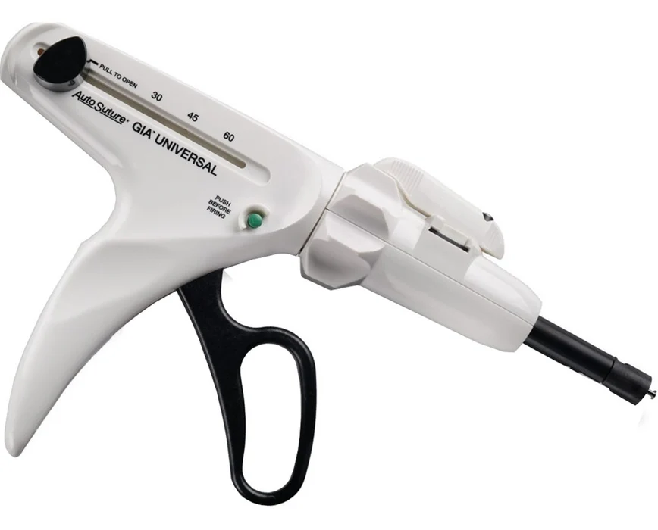
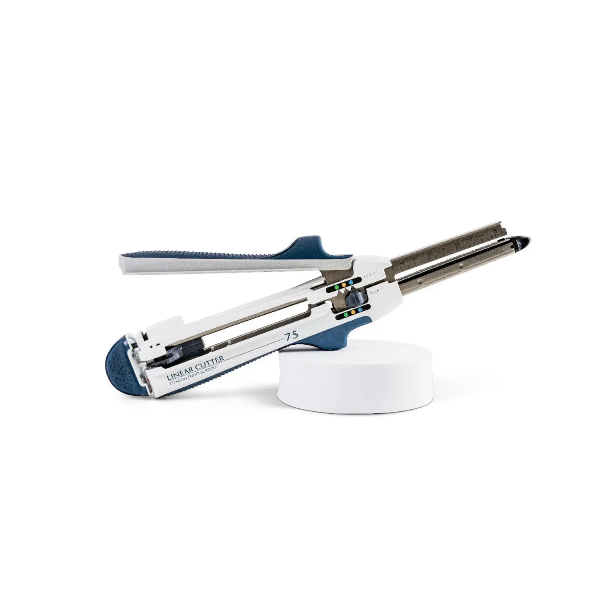
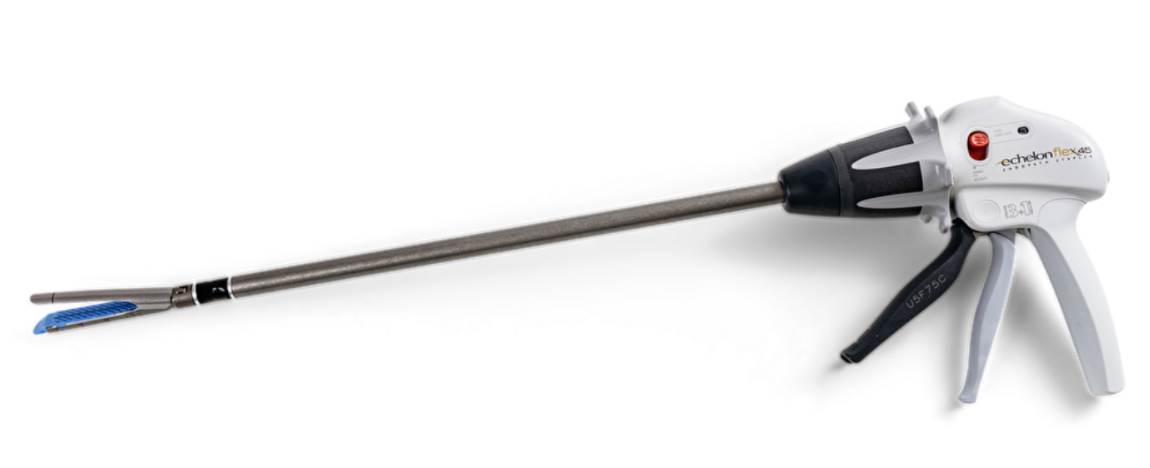
TECNOLOGIA STAPLER CONVENZIONALE
Difficoltà nell’adattarsi a spessori tissutali variabili
Rischio sanguinamento dai fori delle graffe
«tissue slippage» durante la chiusura
Necessità di forza manuale consistente del chirurgo

Slide 13
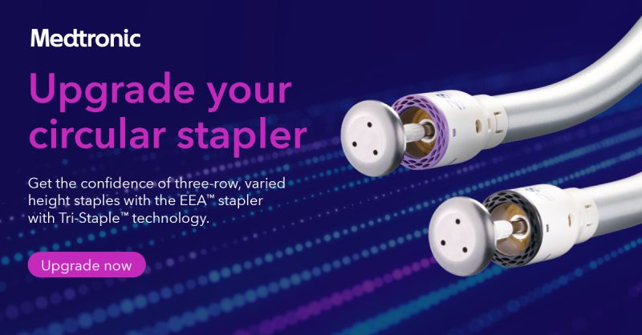
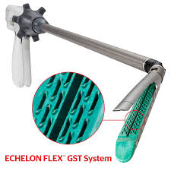
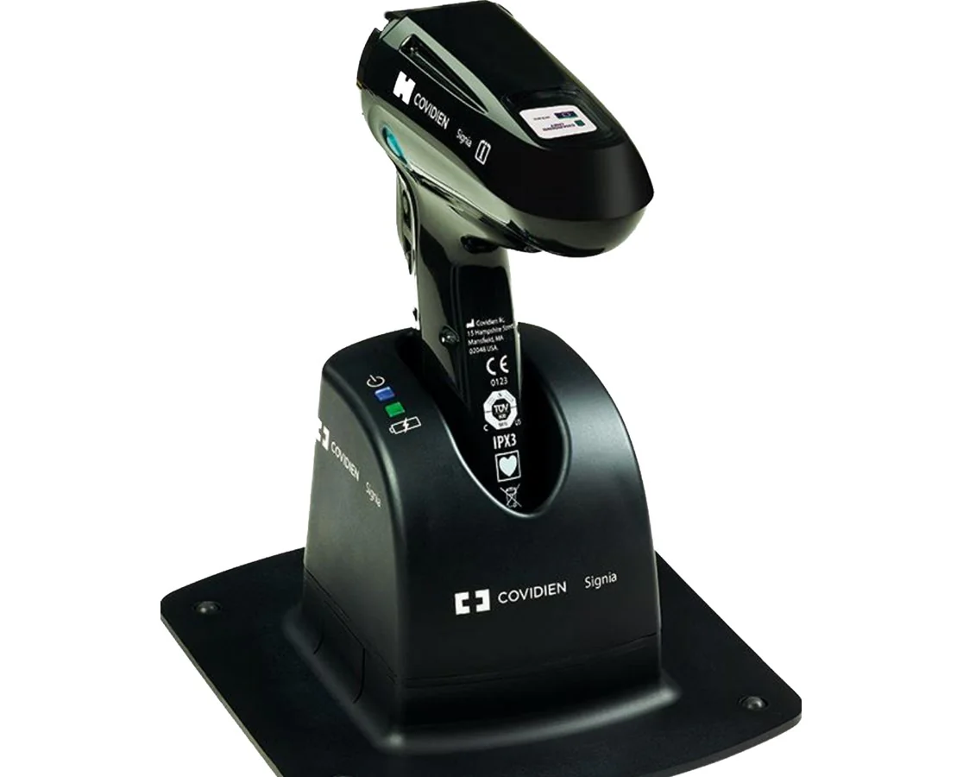
STAPLER MOTORIZZATE
2010
Ridurre le complicanze postoperatorie (leak, sanguinamenti)
Aumentare sicurezza e riproducibilità delle procedure
Facilitare l’uso in tessuti difficili (spessi, fibrotici, edematosi)
Ridurre la variabilità legata all’operatore
Riduzione tempi operatori e costi

Slide 14
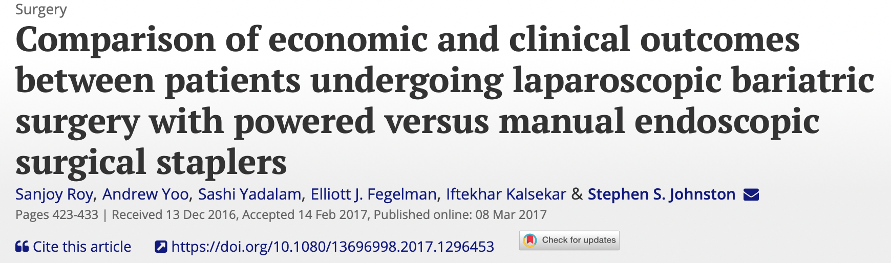
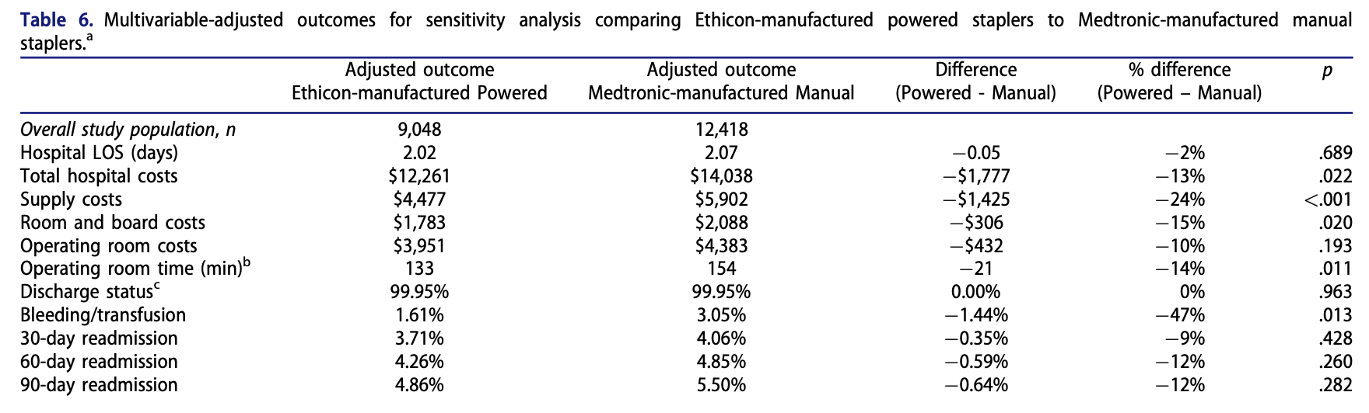

Slide 15
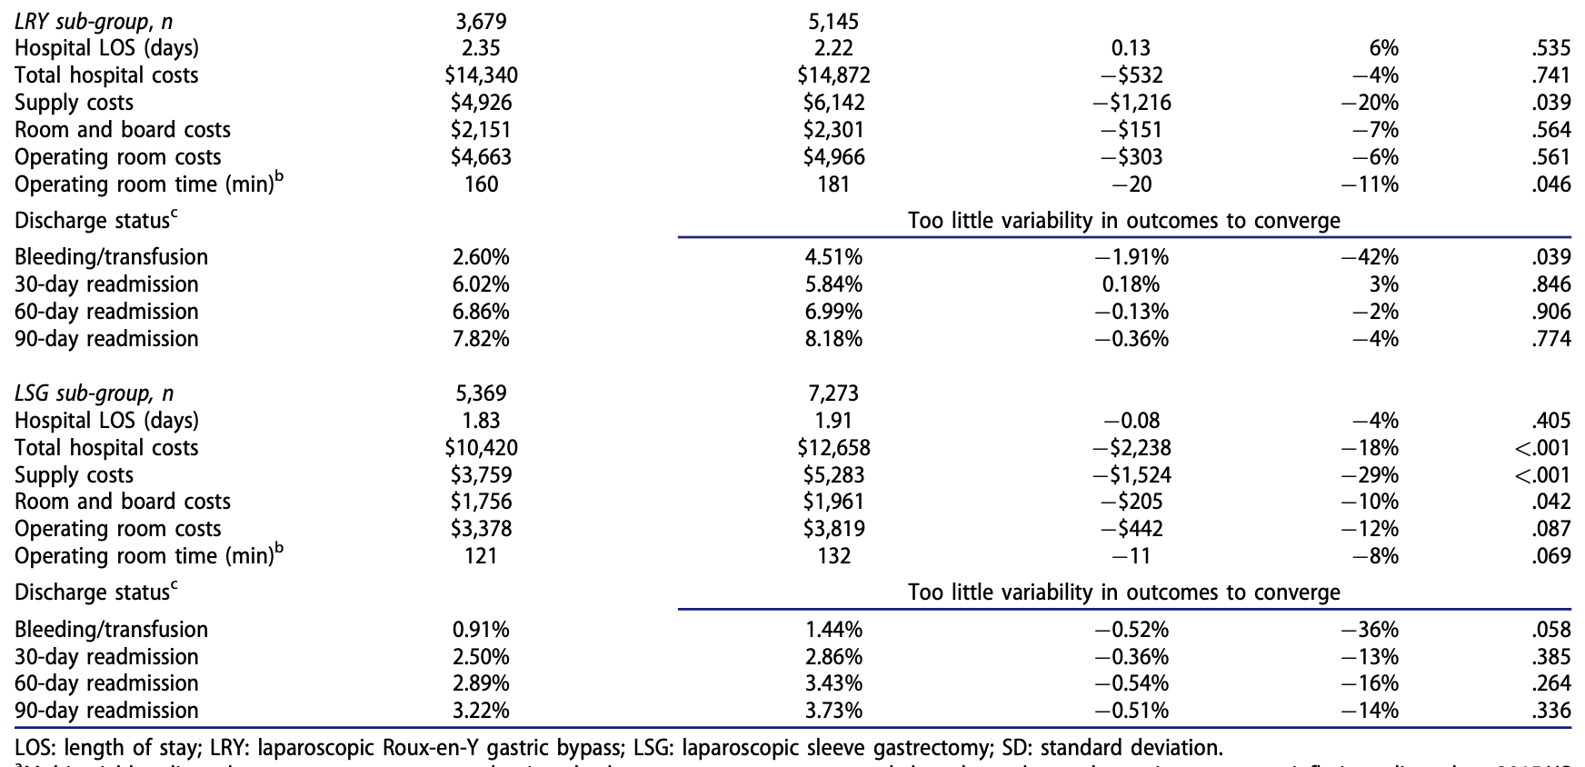

Slide 16
BENEFIT OF THE POWERED DEVICE
Increased stability
Superior control of tissue movement
Less damage to tissue
Formation of a more integrated staple line
Speed and procedural economy – Intelligent feedback
Pshycological freedom to focus on the patient and to plan ahead of the next steps
Reducing surgical stress

Slide 17
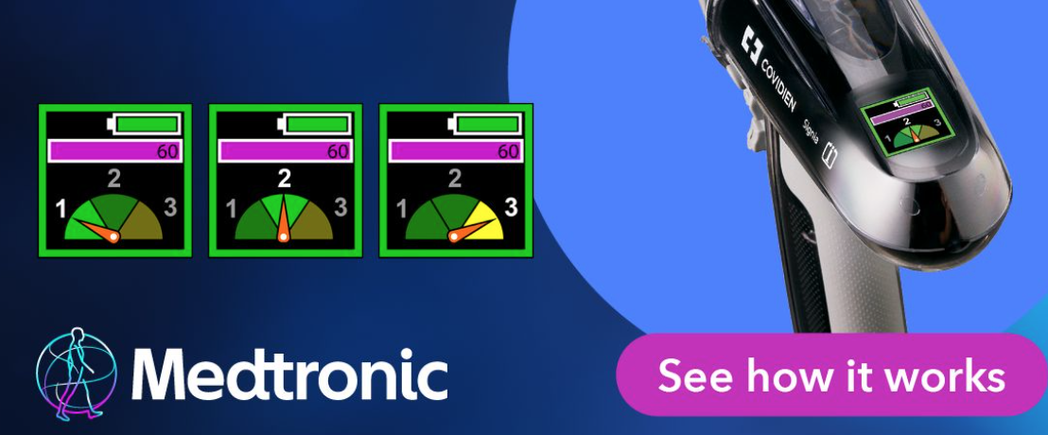
FEEDBACK INTELLIGENTE
Feedback in tempo reale sulla variabilità tissutale
Misura la forza di applicazione della sutura
Regola la velocità in base alla misura della variabilità tissutale
ADAPTIVE FIRING

Slide 18

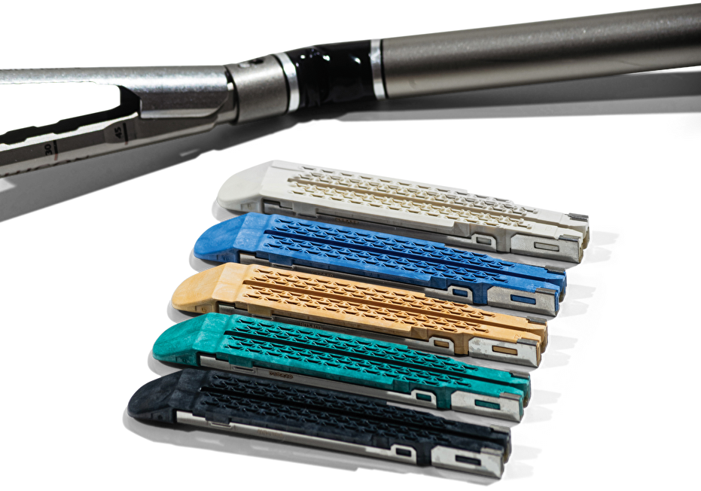
FEEDBACK INTELLIGENTE
Compressione graduale con eliminazione del fluido tissutale
Superficie con grip che mantiene in sede il tessuto durante la sparata

Slide 19
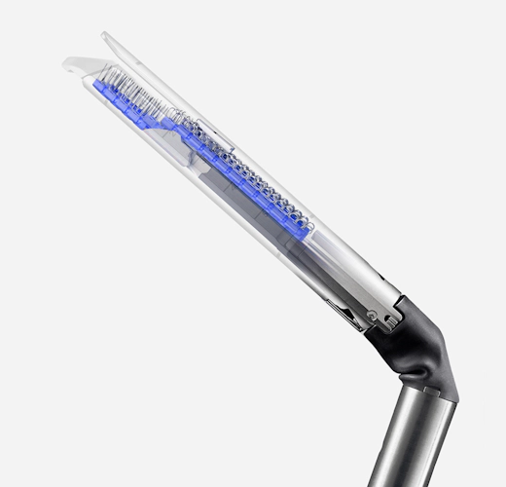
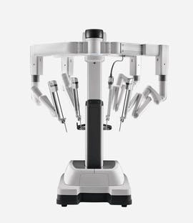
DIREZIONI FUTURE
INTEGRAZIONI CON LA ROBOTICA
SENSORI DI PERFUSIONE TISSUTALE IN TEMPO REALE
MATERIALI BIOINTELLIGENTI PER GRAFFE E RINFORZI

Slide 20
CONCLUSIONI
La tecnologia delle suturatrici in chirurgia bariatrica ha compiuto progressi significativi.
Stapler motorizzate, Feedback tissutale, Design delle graffe e Buttressing mirano a migliorare la sicurezza e l'efficacia delle procedure.
Le evidenze attuali suggeriscono benefici soprattutto in termini di riduzione del sanguinamento, gestione di tessuti complessi e durata della degenza ospedaliera.
La tecnologia è uno strumento potente, ma il giudizio clinico e l'abilità del chirurgo rimangono fondamentali.

Slide 21
Grazie

